Slide 1
Reliability of the Italian cadastral system
data quality and improvement prospects
Eng. Franco MAGGIO
(Central Director for Cadastral, Cartographic and Land Registration Services)
Eng. Arturo ANGELINI
(Responsible for the Cadastral Operating Methodologies Office )

Slide 2
Agenda
Reliability of the Italian cadastral system
data quality and improvement prospects
Data quality characteristics and critical issues
The main data quality improvement activities put in place

Slide 3
Agenda
Reliability of the Italian cadastral system
data quality and improvement prospects
Data quality characteristics and critical issues
The main data quality improvement activities put in place

Slide 4
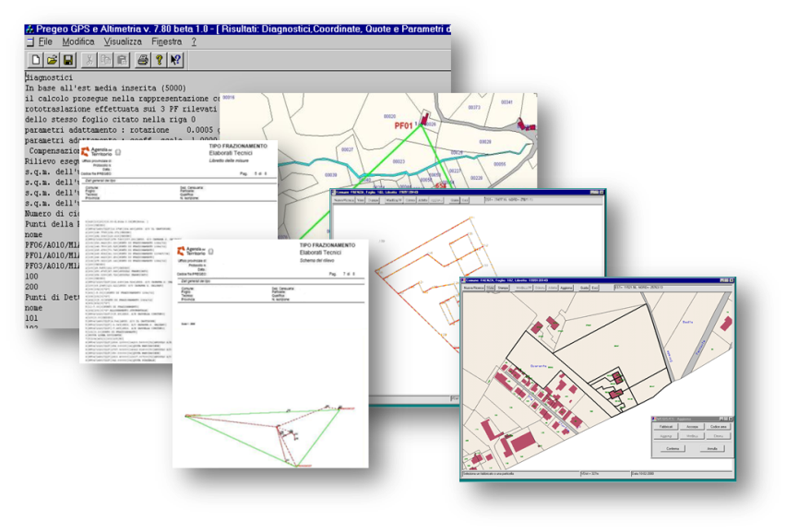
Data quality characteristics and critical issues
Entry
Storage
Processing
Use
The cadastral information system
It is the component of the Organizing System of the Italian Cadastral Administration that manages the related informative processes
\
The cadastral data
It is the informative element of the system: a complex entity consisting of several components different in nature: technical, economical, juridical, descriptive, geometrical, graphical.

Slide 5
Data quality characteristics and critical issues
COMPLETENESS – the presence in the DBs of all the expected information is necessary for a correct understanding
Data quality characteristics
ACCURACY – information has to be accurate and consistent with each other
UPDATING – information has to be constantly updated in order to make it useful
UPDATING
COMPLETENESS
Reliability
ACCURACY
The RELIABILITY
of the Italian cadastral system
is the aptitude to produce over time integrated, consistent and updated information without errors

Slide 6
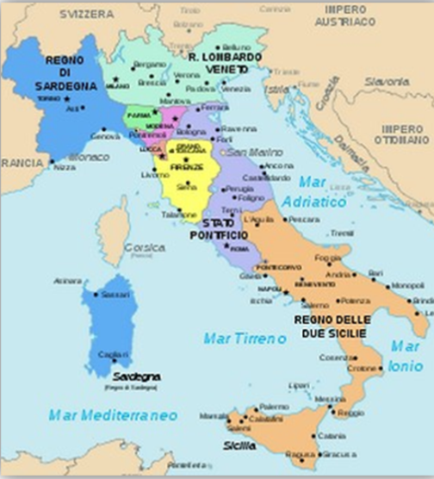
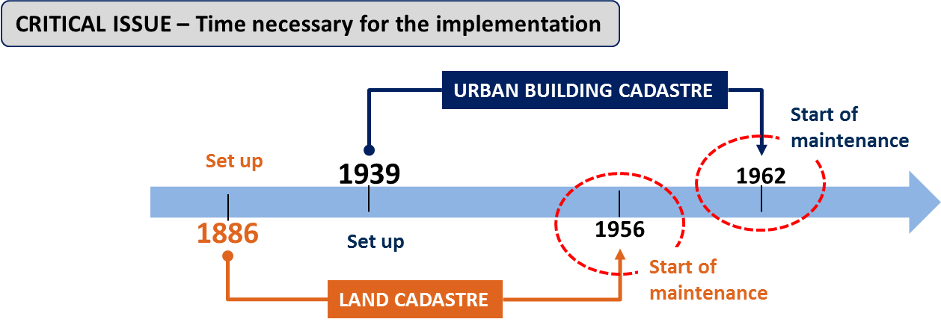
Data quality characteristics and critical issues
1861 – Cadastres before the Unification of Italy
CRITICAL ISSUE – The Origin
22 different Cadastres, only 8 of which based on geometrical data
Aim of the
Italian Cadastre
at 1861
Uniform principles and procedures for the whol national territory
Based on geometrical data (parcel based with regard to its shape, size and georefence)
Equalization of land taxation

Slide 7
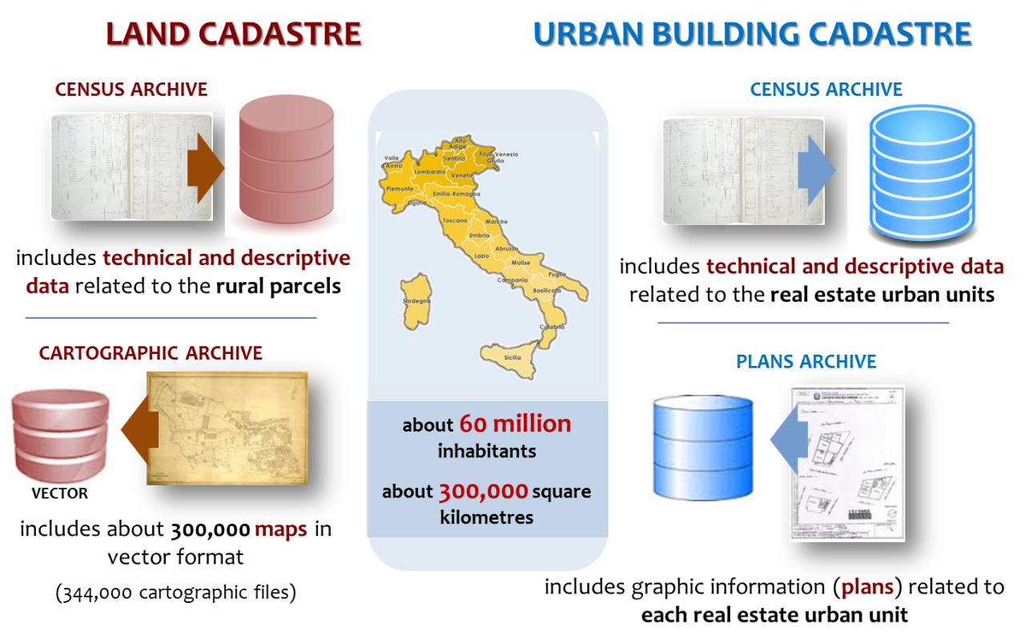
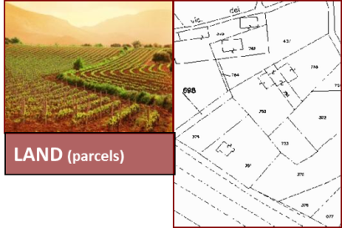
Data quality characteristics and critical issues
CRITICAL ISSUE – The structure and the contents of the cadastral archives
Comprises four archives which are different in nature (alphanumerical or graphic)
LAND CADASTRE
URBAN BUILDING CADASTRE
about 85,5 millions of cadastral parcels
about 73,5 millions of buildings or parts of them

Slide 8
Data quality characteristics and critical issues
CRITICAL ISSUE – Updating based on the owner declaration
Updating is essentially delegated to real estate or land owners, through technical professionals qualified to draft cadastral updating documents

Slide 9
Agenda
Reliability of the Italian cadastral system
data quality and improvement prospects
Data quality characteristics and critical issues
The main data quality improvement activities put in place

Slide 10
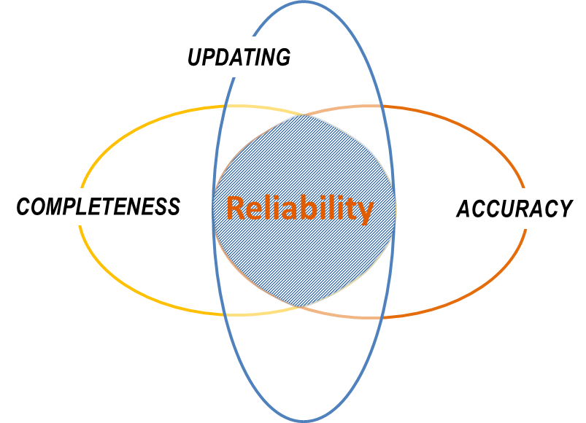
The main data quality improvement activities initiated
Some of the main activities put in place
Reliability of the Italian cadastral system
a
The identification of “hidden buildings”
b
Activation of the “Register of Holders (AdT)”
c
The national archive of urban streets and house numbers “ANNCSU”
d
Rural buildings to be registered at Urban Building Cadastre
e
Improvement of the quality of the cadastral mapping system

Slide 11
a
The identification of “hidden buildings”
Automatic identification of buildings not declared to cadastre

Slide 12
b
Activation of the “Register of Holders (AdT)”
The Register of Holders (AdT) is part of a wider project for the implementation of the Integrated Real Estate Register (A.I.I.)
D.Lgs. 78/2010
The main purposes of the activation of the Integrated Real Estate Register are the:
full integration of the databases available to the Agency made and historically managed as different systems
to provide effective support to the general and local real estate taxation, to correctly identify OBJECT and SUBJECT
Integrated Real Estate Register (A.I.I.)
AdT - Register of Holders
It allows to define the correct identification of the subjects holding title to a property for tax purposes
improves data quality through the qualified representation of their relationships and the full integration of cadastral and land registry archives
SIT - Integrated System of Territory

Slide 13
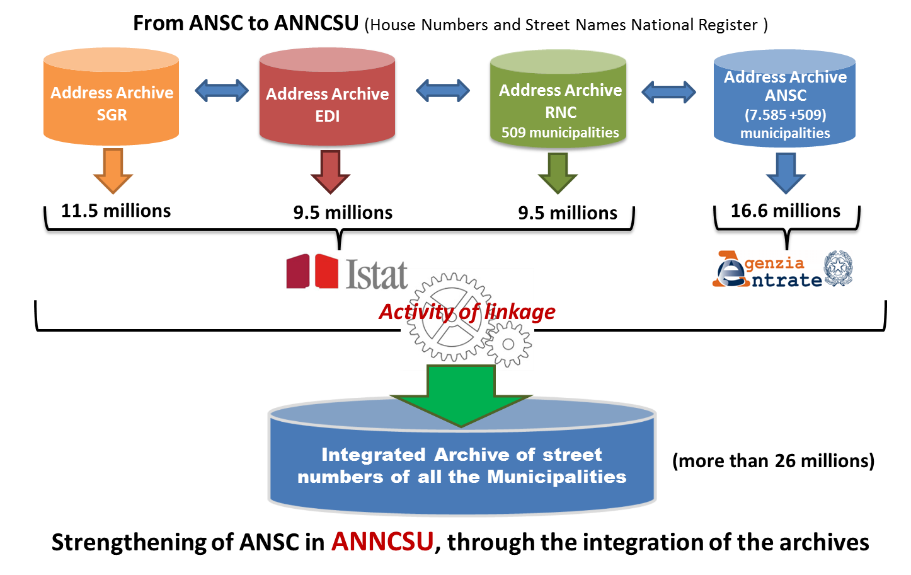
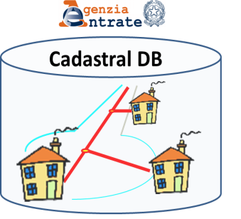
c
The national archive of urban streets and house numbers “ANNCSU”
First ANSC establishment, which contains the Street names’ registers of all the Italian Municipalities, was initially carried out on the basis of toponyms contained in the addresses of the housing units registered in the cadastral database, integrated with external sources
House Numbers and Street Names National Register (ANSC)

Slide 14
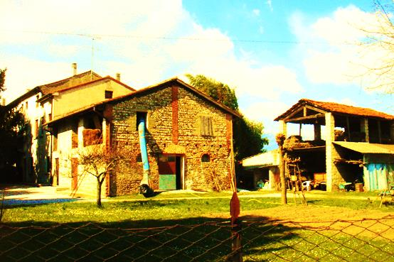
d
Rural buildings to be registered at Urban Building Cadastre
Till 1994 the Rural Buildings were registered only in the Land Cadastre (representation in the map and description of use)
By Law n. 133 of 1994 the registration of the Rural Building in the Urban Building Cadastre (that took the name of comprehensive BUILDINGS CADASTRE) was provided.
In order to put in evidence the "rural character" of a building registered in the Buildings Cadastre, for the fiscal advantages close connected to this condition, the law by decree n. 201 of 2011 provided a specific cadastral annotation for the buildings under this condition.
In order to press the owner for the declaration (mandatory) to the Buildings Cadastre of the Rural Buildings, the Cadastral Administration carried out several communication at national, regional and provincial level.

Slide 15
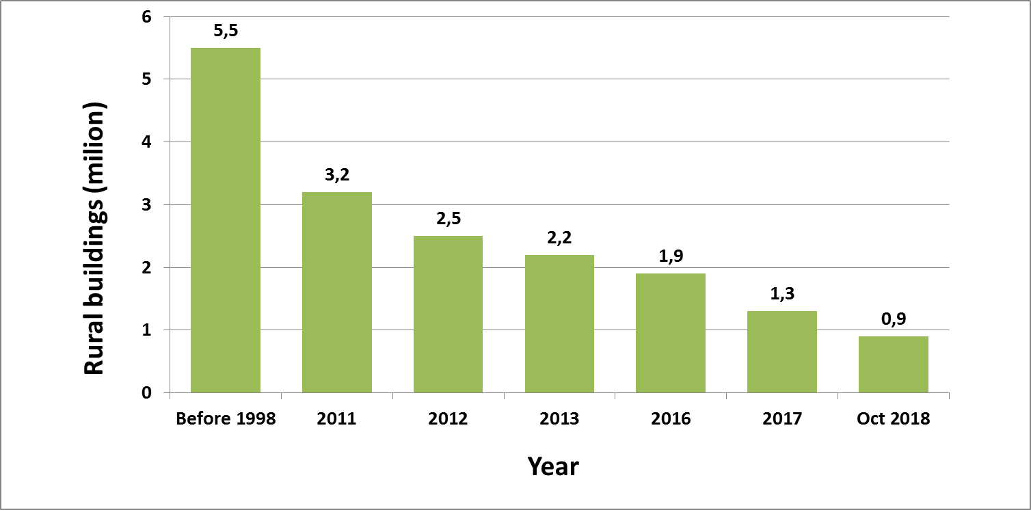
d
Rural buildings to be registered at Urban Building Cadastre
Till 1998 the rural buildings registered only in the Land Cadastre were about 5,5 millions
At the beginning of 2011, the rural buildings still registered only in the Land Cadastre were more than 3,2 millions
After the coming into force of the law by decree n. 201 of 2011, this number was constantly decreasing :
2,5 millions in 2012
2,2 millions in 2013
1,8 millions at the end of 2016
1,3 millions at the end of 2017
0,9 millions at October 2018
The rapid decrease observed in the last years depends both from the owners declarations and from activities carried out by the cadastral Administration in order to remove errors in the cadastral DBs

Slide 16
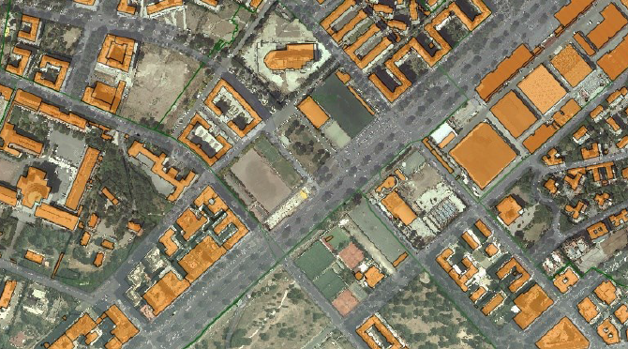
e
Improvement of the quality of the cadastral mapping system
Evolving projects of the cadastral cartographic system
The project activities are aimed at overcoming some critical issues arising from:
the process of creating the original (historical) maps
paper cartography computerisation phase

Slide 17
e
Improvement of the quality of the cadastral mapping system
Evolving projects of the cadastral cartographic system
The carrying out of these activities makes completely usable and interoperable the cartographic information required for achieving the fiscal policy objectives and for the land management policies
Recovery of maps accuracy and topological consistency between adjoining maps
Remaking of the cartography in the Lombardia Region
The main undertaken projects:

Slide 18
1
e
Evolving projects of the cadastral cartographic system
Recovery of maps accuracy and topological consistency between adjoining maps
Causes
Goals
The transposing of the cadastral cartography from paper to a digital format, carried out through the acquisition of the cadastral maps raster images, then digitalised to get related files in vector format, caused a deterioration of the map precision, making it necessary to recover the distortions of vector maps.
Improve the QUALITY of cartography
Improve the usability of WMS services and the “Geoportal”
PROJECT ACTIVITIES
Step 1
Distortions adjustment of the original maps – geo-referencing of the original maps
Accuracy recovery of the digital vector maps through calibration on the original maps
Removal of the distortions existing in the digital vector maps
Step 2
Creation of the topological consistency between adjoining maps
Automatic creation of the topological consistency between adjoining maps using the raster images of the original maps
Step 3

Slide 19
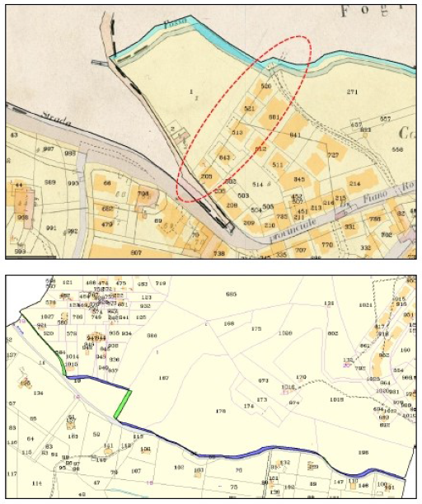
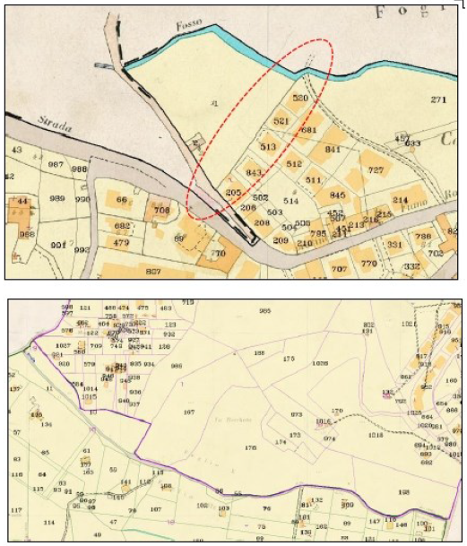
1
e
Evolving projects of the cadastral cartographic system
Recovery of maps accuracy and topological consistency between adjoining maps
1 Overlapping of the vector map file on the original map before the calibration
1 Overlapping of the vector map file on the original map after the calibration
2 Overlapping of the vector map files on the original maps before the topological consistency recovery
2 Overlapping of the vector map files on the original maps after the topological consistency recovery

Slide 20
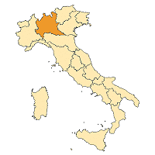
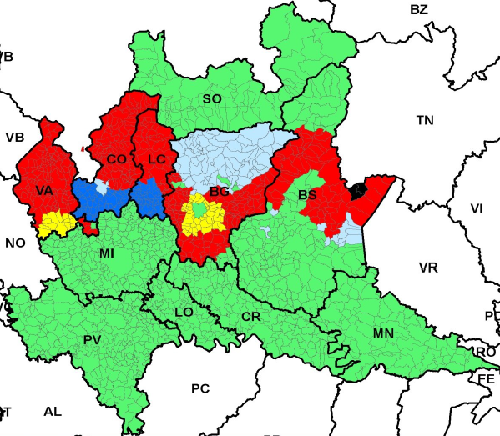
3
e
Evolving projects of the cadastral cartographic system
Remaking of the cartography in the Lombardy Region
Causes
Goals
About 15,000 cadastral maps coming from the cadastres existing before the unification of Italy, included in some Provinces of Lombardy, made using the open perimeter system, not referred to any reference points network and surveyed through the plane table, oriented to the North through a compass.
To create a new cadastral cartography in these territories
Improve the QUALITY of cartography
Improve the usability of WMS services and the “Geoportal”
Grundbuch system
Ordinary cadastral maps (parcel with close perimeter)
Pre - Unification maps (parcel with open perimeter)
Availability of maps derived by aero photogrammetry in the '90, but not yet under the maintenance phase
Availability of maps derived by aero photogrammetry in the '80, but not yet under the maintenance phase
Availability of maps surveyed on the ground in the '70, but not yet under the maintenance phase

Slide 21
Reliability of the Italian cadastral system
data quality and improvement prospects
Eng. Franco MAGGIO
(Central Director for Cadastral, Cartographic and Land Registration Services)
Eng. Arturo ANGELINI
(Responsible for the Cadastral Operating Methodologies Office)
Many thanks for your kind attention

